Slide 1


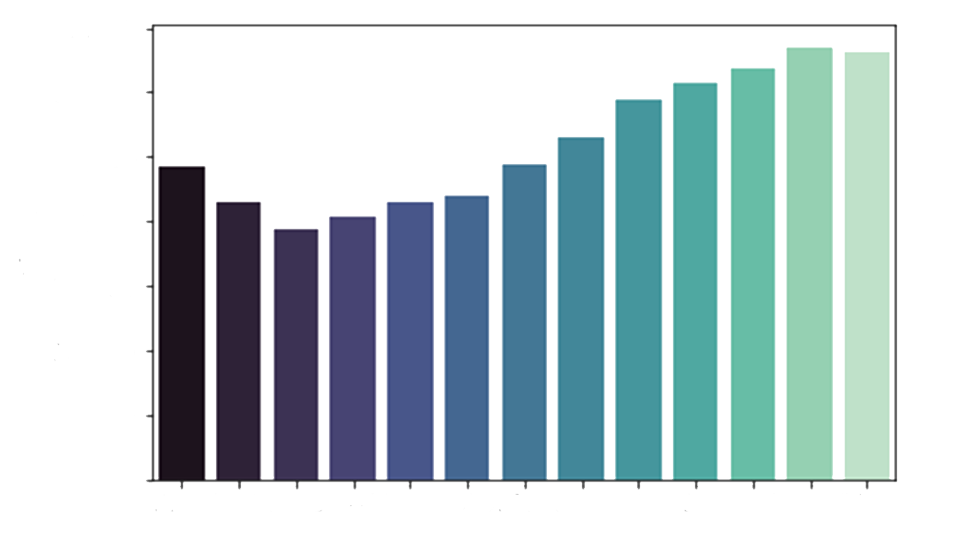
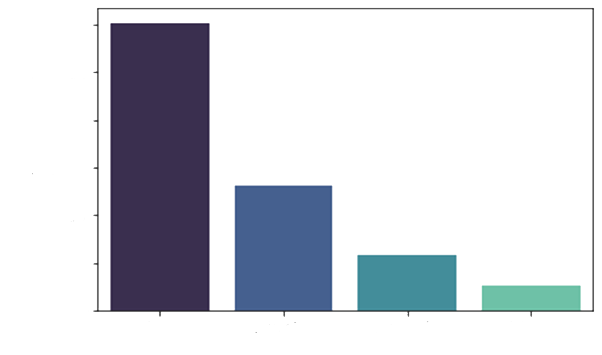
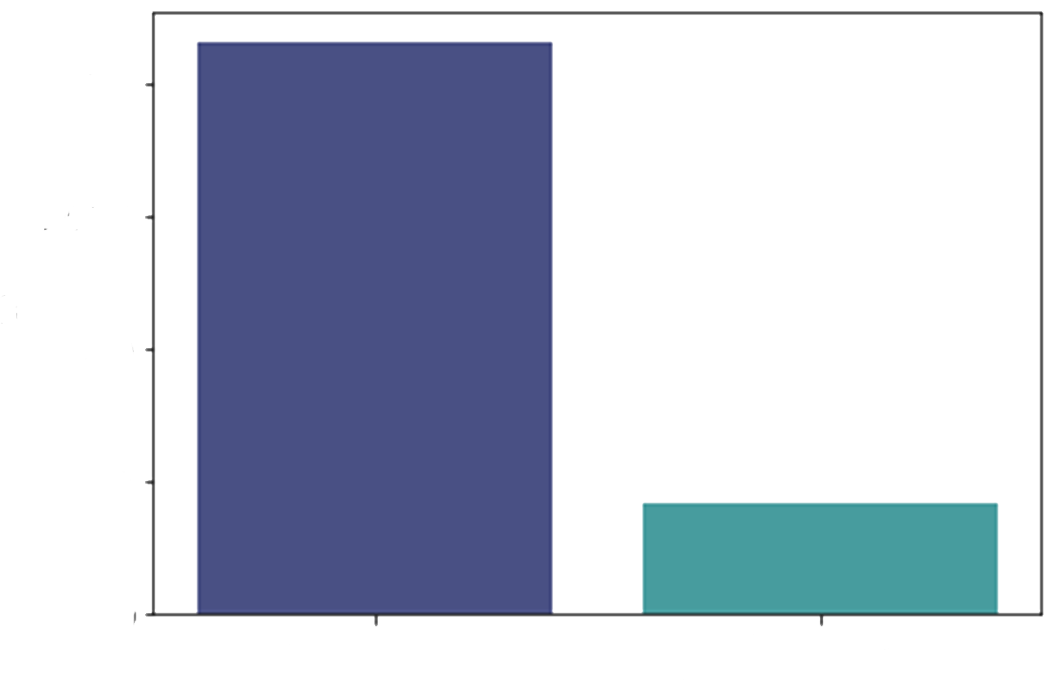
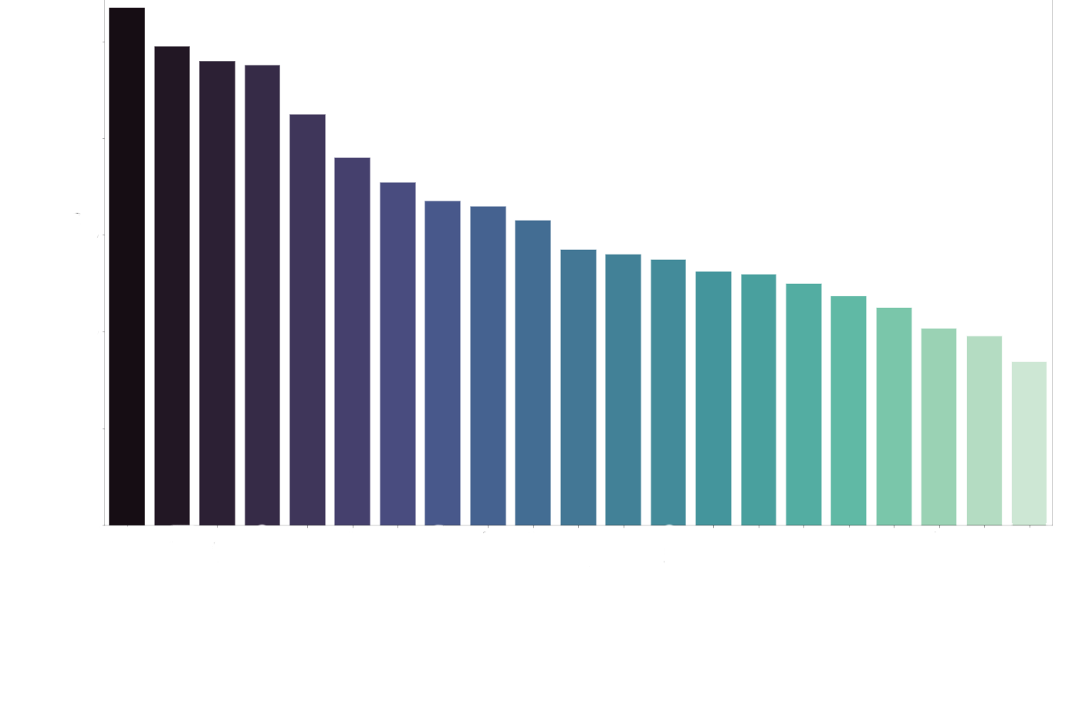
RESEARCH QUESTIONS
ANALYSIS OF PROPERTY PRICES IN IRELAND
An accurate house price prediction is important for prospective homeowners, real estate developers, investors, banks, governments, tax assessors, insurers, and mortgage lenders. The main objective of this study is to analyze the property prices of Ireland from 2010 to 2022 collected from the PSRA website. Factors included in this study for house price prediction are county, year, province, location of property, property size and type.
Has the property prices increased over the years?
Which county has the highest prices for properties?
Does the property price depend on which county the house is in? Is there any relationship between the counties and the prices?
Is there any relationship between the size of the properties, type of properties (like new or second hand) and the property prices?
INTRODUCTION
GINU VARGHESE
DEPARTMENT OF COMPUTING SCIENCE AND MATHEMATICS
D00251842@STUDENT.DKIT.IE
The entire project is based on CRISP-DM methodology. Statistical analyses such as ANOVA and MLR and various plots using seaborn and matplotlib were generated for the initial analysis of the property prices.
METHODS AND RESULTS
Figure 1. Property Price Vs Year.
Figure 2. Provinces Vs Count
Figure 3. Property Type Vs Count
The results from the ANOVA and MLR implies that the attributes ‘year’, ‘province’, ‘property_description’ and ‘location’ has significant effect on the property prices. From different visualizations generated, it is evident that prices are increasing every year and higher number of houses are sold in Leinster province and the most sold houses are secondhand. It is also revealed that the Post codes in Dublin are also having an impact on the house prices. For future research, I will be using Hedonic regression, Random Forest, SVM and Linear Regression Machine learning techniques to analyze and predict the house prices.
REFERENCES
Phan, T.D. (2019). Housing price prediction using machine learning algorithms: the case of Melbourne city, Australia. Proceedings - International Conference on Machine Learning and Data Engineering.
Thamarai, M. and Malarvizhi, S.P. (2020). Information Engineering and Electronic Business. Information Engineering and Electronic Business.
Jeffrey W. Kaeli, Hanumant Singh, and Roy Armstrong, "Morphological Image Recognition of Deep-Water Reef Corals" (Blacksburg, VA: Virginia Tech, October 2005).
CONCLUSION
ACKNOWLEDGEMENT
The Data used for this research was taken from the Residential Property Price Register page of PSRA website, https://propertypriceregister.ie.
Figure 4. Post Code Vs Median of House Prices

Slide 2


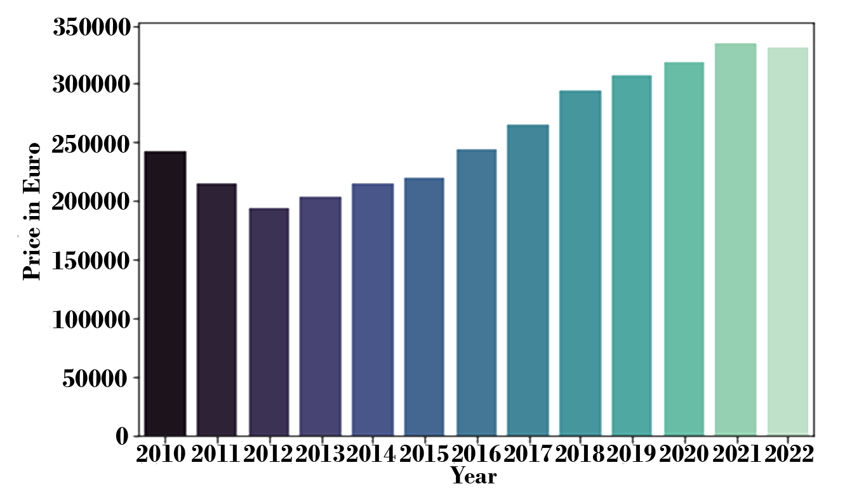
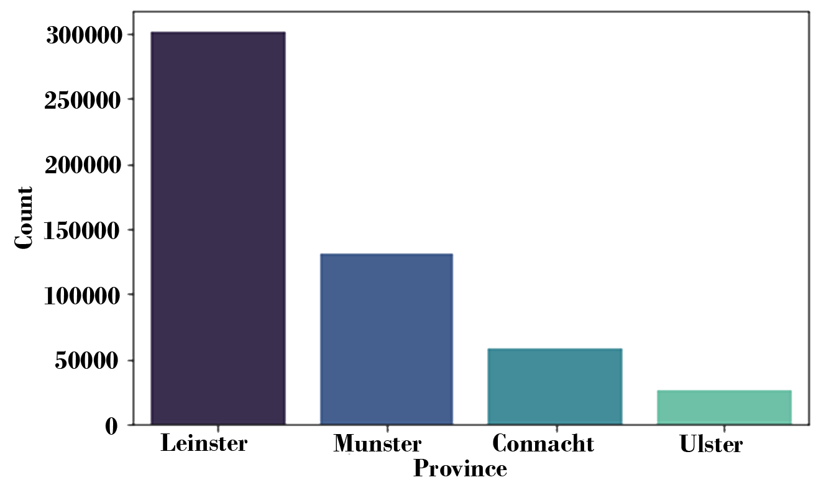
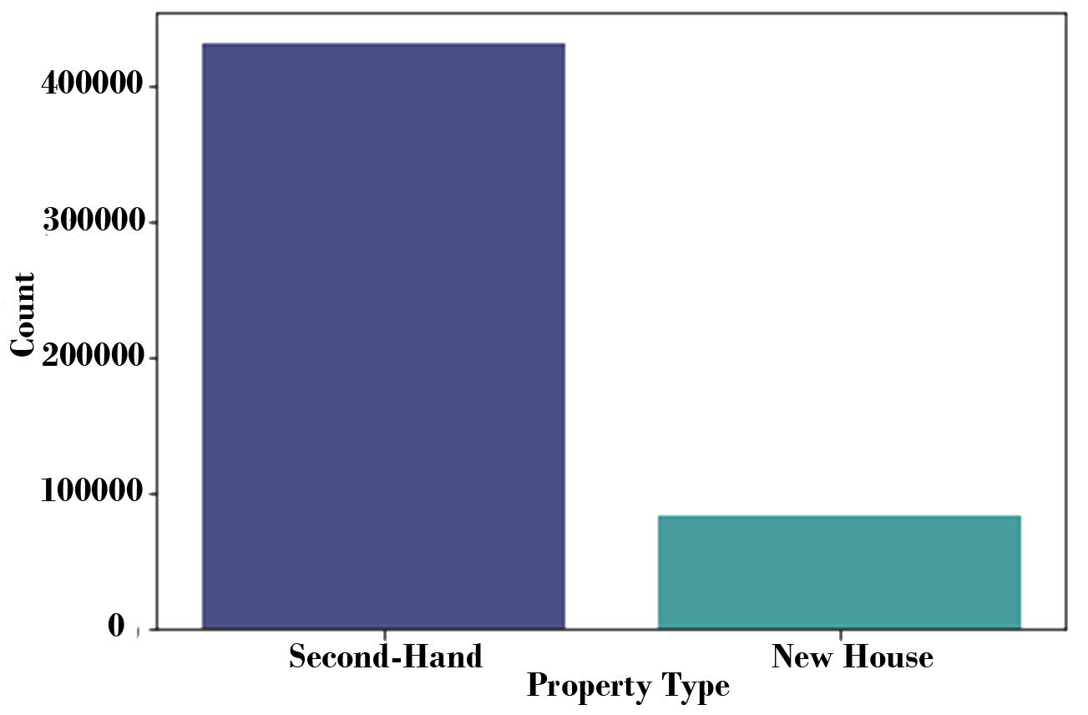
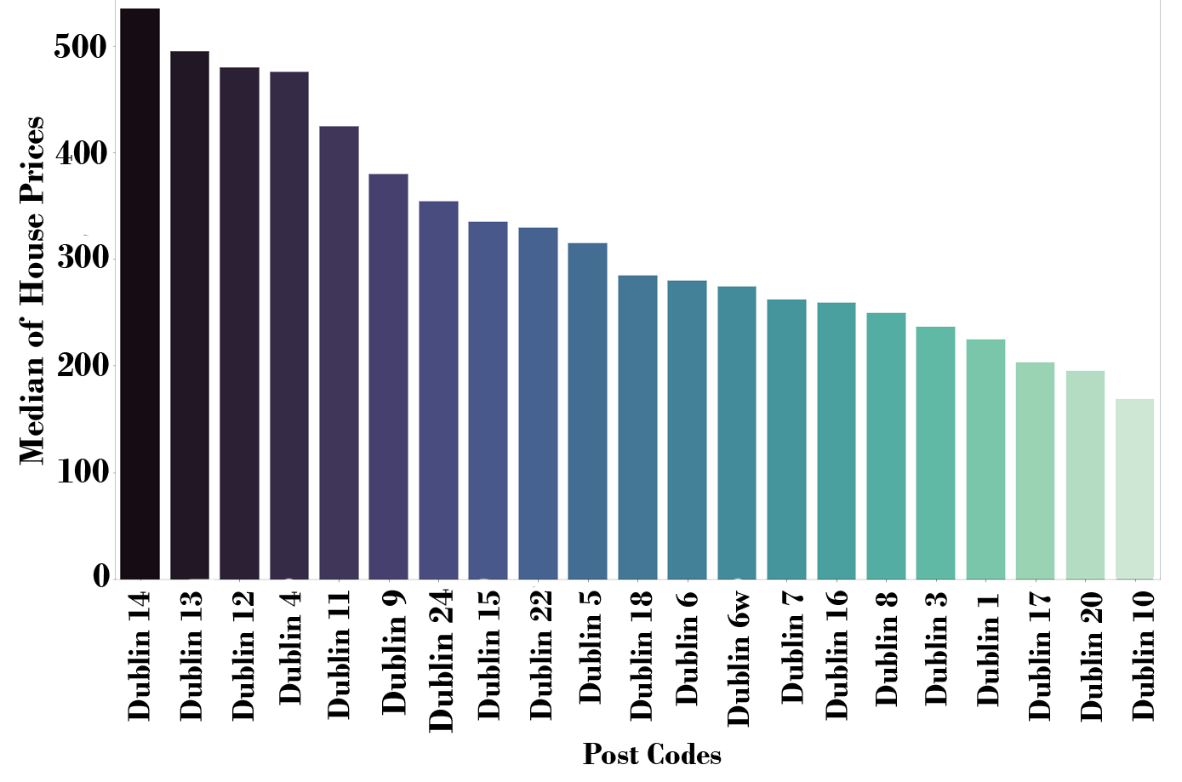
RESEARCH QUESTIONS
ANALYSIS OF PROPERTY PRICES IN IRELAND
An accurate house price prediction is important for prospective homeowners, real estate developers, investors, banks, governments, tax assessors, insurers, and mortgage lenders. The main objective of this study is to analyze the property prices of Ireland from 2010 to 2022 collected from the PSRA website. Factors included in this study for house price prediction are county, year, province, location of property, property size and type.
Has the property prices increased over the years?
Which county has the highest prices for properties?
Does the property price depend on which county the house is in? Is there any relationship between the counties and the prices?
Is there any relationship between the size of the properties, type of properties (like new or second hand) and the property prices?
INTRODUCTION
GINU VARGHESE
DEPARTMENT OF COMPUTING SCIENCE AND MATHEMATICS
D00251842@STUDENT.DKIT.IE
The entire project is based on CRISP-DM methodology. Statistical analyses such as ANOVA and MLR and various plots using seaborn and matplotlib were generated for the initial analysis of the property prices.
METHODS AND RESULTS
Figure 1. Property Price Vs Year.
Figure 2. Provinces Vs Count
Figure 3. Property Type Vs Count
The results from the ANOVA and MLR implies that the attributes ‘year’, ‘province’, ‘property_description’ and ‘location’ has significant effect on the property prices. From different visualizations generated, it is evident that prices are increasing every year and higher number of houses are sold in Leinster province and the most sold houses are secondhand. It is also revealed that the Post codes in Dublin are also having an impact on the house prices. For future research, I will be using Hedonic regression, Random Forest, SVM and Linear Regression Machine learning techniques to analyze and predict the house prices.
REFERENCES
Phan, T.D. (2019). Housing price prediction using machine learning algorithms: the case of Melbourne city, Australia. Proceedings - International Conference on Machine Learning and Data Engineering.
Thamarai, M. and Malarvizhi, S.P. (2020). Information Engineering and Electronic Business. Information Engineering and Electronic Business.
Jeffrey W. Kaeli, Hanumant Singh, and Roy Armstrong, "Morphological Image Recognition of Deep-Water Reef Corals" (Blacksburg, VA: Virginia Tech, October 2005).
CONCLUSION
ACKNOWLEDGEMENT
The Data used for this research was taken from the Residential Property Price Register page of PSRA website, https://propertypriceregister.ie.
Figure 4. Post Code Vs Median of House Prices

Slide 3


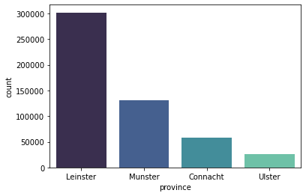
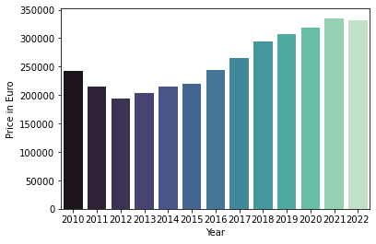
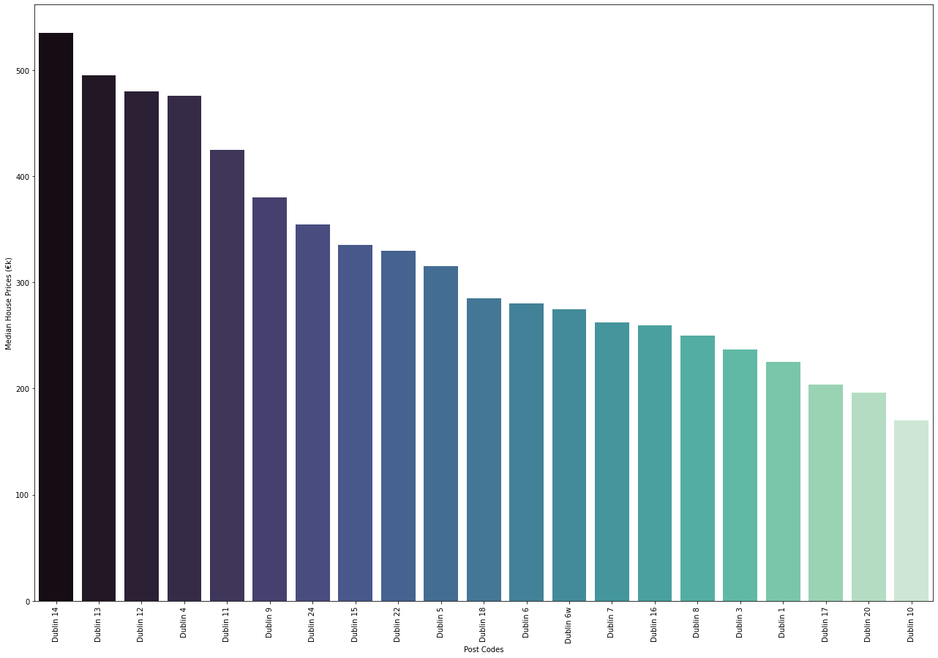
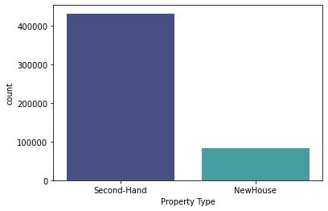
Analysis of Property Prices in Ireland
Ginu Varghese
Department of Computing Science And Mathematics
D00251842@student.dkit.ie
Introduction
An accurate house price prediction is important for prospective homeowners, real estate developers, investors, banks, governments, tax assessors, insurers, and mortgage lenders. The main objective of this study is to analyze the property prices of Ireland from 2010 to 2022 collected from the PSRA website. Factors included in this study for house price prediction are county, year, province, location of property, property size and type.
Methods And Results
The entire project is based on CRISP-DM methodology. Statistical analyses such as ANOVA and MLR and various plots using seaborn and matplotlib were generated for the initial analysis of the property prices.
Conclusion and Future work
The results from the ANOVA and MLR implies that the attributes ‘year’, ‘province’, ‘property_description’ and ‘location’ has significant effect on the property prices. From different visualizations generated, it is evident that prices are increasing every year and higher number of houses are sold in Leinster province and the most sold houses are secondhand. It is also revealed that the Post codes in Dublin are also having an impact on the house prices. For future research, I will be using Hedonic regression, Random Forest, SVM and Linear Regression Machine learning techniques to analyze and predict the house prices.
Figure 2. Another example poster with caption at 36 points [2].
Figure 1. Property Price Vs Year.
Figure 2. Another example poster with caption at 36 points [2].
Research Questions
Has the property prices increased over the years?
Which county has the highest prices for properties?
Does the property price depend on which county the house is in? Is there any relationship between the counties and the prices?
Is there any relationship between the size of the properties, type of properties (like new or second hand) and the property prices?
Acknowledgments
The Data used for this research was taken from the Residential Property Price Register page of PSRA website, https://propertypriceregister.ie.
References (Calibri, 32 points)
Phan, T.D. (2019). Housing price prediction using machine learning algorithms: the case of Melbourne city, Australia. Proceedings - International Conference on Machine Learning and Data Engineering.
Thamarai, M. and Malarvizhi, S.P. (2020). Information Engineering and Electronic Business. Information Engineering and Electronic Business.
Jeffrey W. Kaeli, Hanumant Singh, and Roy Armstrong, "Morphological Image Recognition of Deep-Water Reef Corals" (Blacksburg, VA: Virginia Tech, October 2005).
Figure 2. Another example poster with caption at 36 points [2].

Slide 4
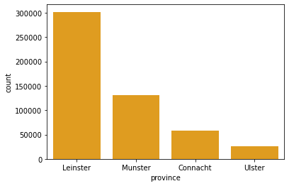
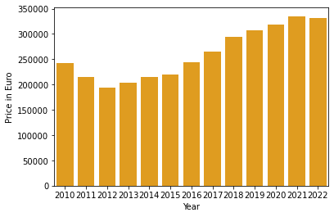
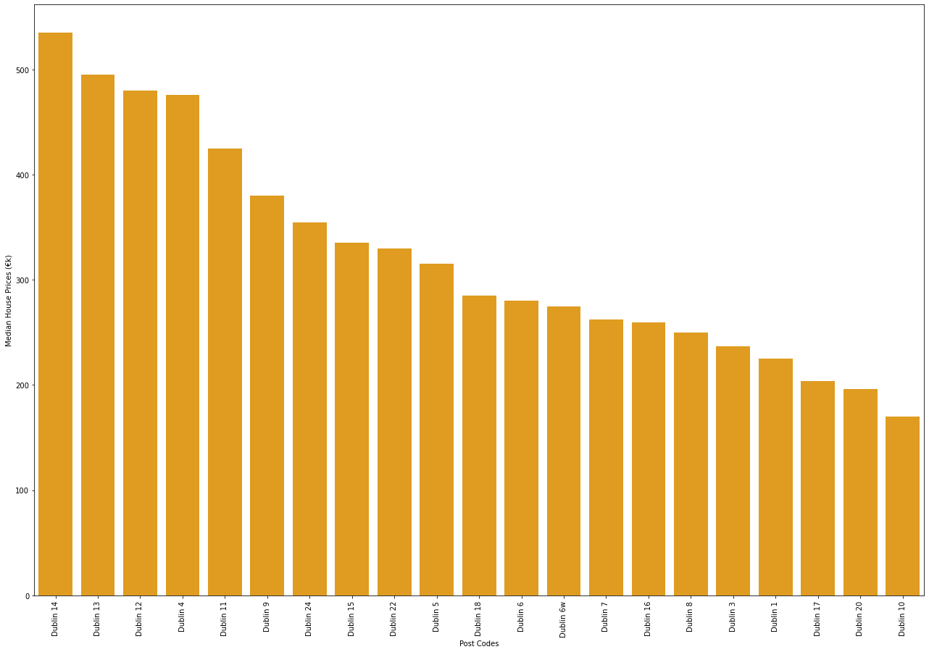
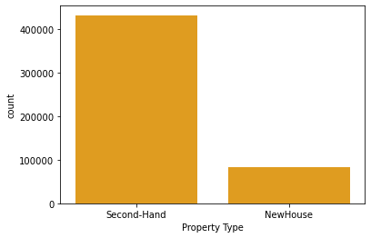
Analysis of Property Prices in Ireland
Ginu Varghese
Department of Computing Science And Mathematics
D00251842@student.dkit.ie
Introduction
The property prices are increasing every year and it is demanding the analysis and prediction of property prices. An accurate house price prediction is important for prospective homeowners, real estate developers, investors, banks, governments, tax assessors, insurers, and mortgage lenders. The main objective of this study is to analyze the property prices of Ireland from 2010 to 2022 collected from the PSRA website. Factors influencing the house prices county, year, province, location of property, property size and type are considered for analysis.
Methods And Results
The entire project is based on CRISP-DM methodology. Statistical analyses such as ANOVA and MLR and various plots using seaborn and matplotlib were generated for the initial analysis of the property prices.
Conclusion and Future work
The results from the ANOVA and MLR implies that the attributes ‘year’, ‘province’, ‘property_description’ and ‘location’ has significant effect on the property prices. From different visualizations generated, it is evident that prices are increasing every year and higher number of houses are sold in Leinster province and the most sold houses are secondhand. It is also revealed that the Post codes in Dublin are also having an impact on the house prices. For future research, I will be using Hedonic regression, Random Forest, SVM and Linear Regression Machine learning techniques to analyze and predict the house prices.
Figure 2. Another example poster with caption at 36 points [2].
Figure 1. Property Price Vs Year.
Figure 2. Another example poster with caption at 36 points [2].
Research Questions
Has the property prices increased over the years?
Which county has the highest prices for properties?
Does the property price depend on which county the house is in? Is there any relationship between the counties and the prices?
Is there any relationship between the size of the properties, type of properties (like new or second hand) and the property prices?
Acknowledgments
The Data used for this research was taken from the Residential Property Price Register page of PSRA website, https://propertypriceregister.ie.
References (Calibri, 32 points)
Phan, T.D. (2019). Housing price prediction using machine learning algorithms: the case of Melbourne city, Australia. Proceedings - International Conference on Machine Learning and Data Engineering.
Thamarai, M. and Malarvizhi, S.P. (2020). Information Engineering and Electronic Business. Information Engineering and Electronic Business.
Jeffrey W. Kaeli, Hanumant Singh, and Roy Armstrong, "Morphological Image Recognition of Deep-Water Reef Corals" (Blacksburg, VA: Virginia Tech, October 2005).
Figure 2. Another example poster with caption at 36 points [2].

Slide 5
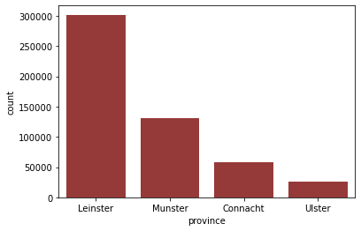
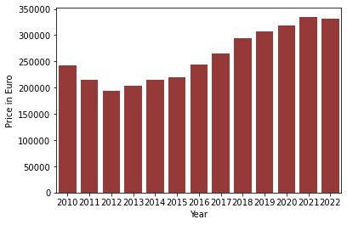
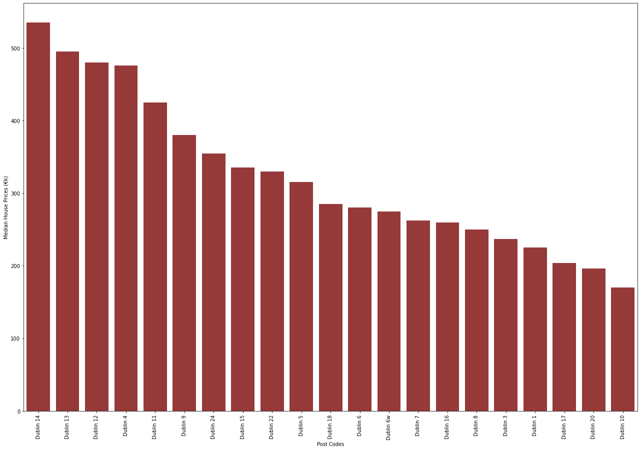
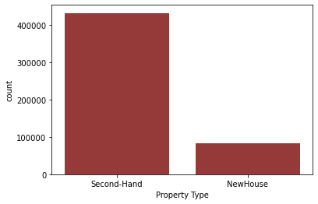
Analysis of Property Prices in Ireland
Ginu Varghese
Department of Computing Science And Mathematics
D00251842@student.dkit.ie
Introduction
The property prices are increasing every year and it is demanding the analysis and prediction of property prices. An accurate house price prediction is important for prospective homeowners, real estate developers, investors, banks, governments, tax assessors, insurers, and mortgage lenders. The main objective of this study is to analyze the property prices of Ireland from 2010 to 2022 collected from the PSRA website. Factors influencing the house prices county, year, province, location of property, property size and type are considered for analysis.
Methods And Results
The entire project is based on CRISP-DM methodology. Statistical analyses such as ANOVA and MLR and various plots using seaborn and matplotlib were generated for the initial analysis of the property prices.
Conclusion and Future work
The results from the ANOVA and MLR implies that the attributes ‘year’, ‘province’, ‘property_description’ and ‘location’ has significant effect on the property prices. From different visualizations generated, it is evident that prices are increasing every year and higher number of houses are sold in Leinster province and the most sold houses are secondhand. It is also revealed that the Post codes in Dublin are also having an impact on the house prices. For future research, I will be using Hedonic regression, Random Forest, SVM and Linear Regression Machine learning techniques to analyze and predict the house prices.
Figure 2. Another example poster with caption at 36 points [2].
Figure 1. Property Price Vs Year.
Figure 2. Another example poster with caption at 36 points [2].
Research Questions
Has the property prices increased over the years?
Which county has the highest prices for properties?
Does the property price depend on which county the house is in? Is there any relationship between the counties and the prices?
Is there any relationship between the size of the properties, type of properties (like new or second hand) and the property prices?
Acknowledgments
The Data used for this research was taken from the Residential Property Price Register page of PSRA website, https://propertypriceregister.ie.
References (Calibri, 32 points)
Phan, T.D. (2019). Housing price prediction using machine learning algorithms: the case of Melbourne city, Australia. Proceedings - International Conference on Machine Learning and Data Engineering.
Thamarai, M. and Malarvizhi, S.P. (2020). Information Engineering and Electronic Business. Information Engineering and Electronic Business.
Jeffrey W. Kaeli, Hanumant Singh, and Roy Armstrong, "Morphological Image Recognition of Deep-Water Reef Corals" (Blacksburg, VA: Virginia Tech, October 2005).
Figure 2. Another example poster with caption at 36 points [2].

Slide 6

RESEARCH QUESTIONS
ANALYSIS OF PROPERTY PRICES IN IRELAND
An accurate house price prediction is important for prospective homeowners, real estate developers, investors, banks, governments, tax assessors, insurers, and mortgage lenders. The main objective of this study is to analyze the property prices of Ireland from 2010 to 2022 collected from the PSRA website. Factors included in this study for house price prediction are county, year, province, location of property, property size and type.
Has the property prices increased over the years?
Which county has the highest prices for properties?
Does the property price depend on which county the house is in? Is there any relationship between the counties and the prices?
Is there any relationship between the size of the properties, type of properties (like new or second hand) and the property prices?
INTRODUCTION
GINU VARGHESE
DEPARTMENT OF COMPUTING SCIENCE AND MATHEMATICS
D00251842@STUDENT.DKIT.IE
The entire project is based on CRISP-DM methodology. Statistical analyses such as ANOVA and MLR and various plots using seaborn and matplotlib were generated for the initial analysis of the property prices.
METHODS AND RESULTS
Figure 1. Property Price Vs Year.
Figure 2. Provinces Vs Count
Figure 3. Property Type Vs Count
The results from the ANOVA and MLR implies that the attributes ‘year’, ‘province’, ‘property_description’ and ‘location’ has significant effect on the property prices. From different visualizations generated, it is evident that prices are increasing every year and higher number of houses are sold in Leinster province and the most sold houses are secondhand. It is also revealed that the Post codes in Dublin are also having an impact on the house prices. For future research, I will be using Hedonic regression, Random Forest, SVM and Linear Regression Machine learning techniques to analyze and predict the house prices.
REFERENCES
Phan, T.D. (2019). Housing price prediction using machine learning algorithms: the case of Melbourne city, Australia. Proceedings - International Conference on Machine Learning and Data Engineering.
Thamarai, M. and Malarvizhi, S.P. (2020). Information Engineering and Electronic Business. Information Engineering and Electronic Business.
Jeffrey W. Kaeli, Hanumant Singh, and Roy Armstrong, "Morphological Image Recognition of Deep-Water Reef Corals" (Blacksburg, VA: Virginia Tech, October 2005).
CONCLUSION
ACKNOWLEDGEMENT
The Data used for this research was taken from the Residential Property Price Register page of PSRA website, https://propertypriceregister.ie.
Figure 4. Post Code Vs Median of House Prices

